Slide 1

Module 1 –C0
By- Ankur Prasad

Slide 2


Linux Task 1
1. Create a new user “student” in Linux.
2. Create a new folder ‘internship’ in the /home/student (student user home directory).
3. Create a new folder ‘my_folder’ inside the student folder.
4. Create a new file ‘my_file’ inside the folder student with the following contents:
Hello
My name is [your name].
My team is [your_team_name].
5. Append the file ‘my_file’ to add the following line at the end of the file: India is my nation.
6. Navigate to the student directory and create a new folder ‘student’.
7. Create three files with some text in the ‘student’ folder.
8. Delete any one file from the three created files.

Slide 3
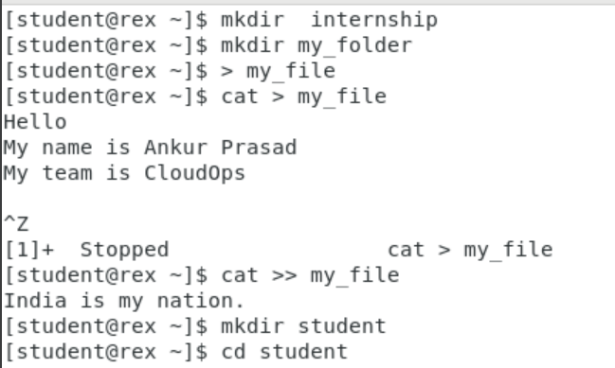
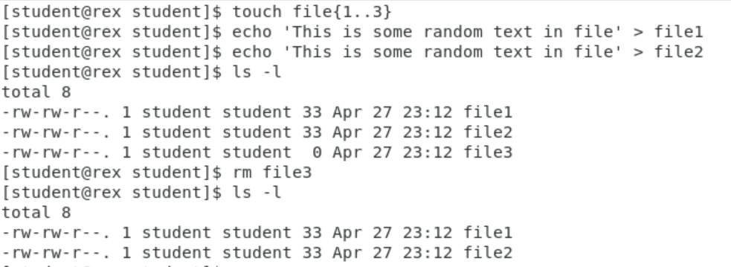


1.
2.

Slide 4

Linux Task 2
1. Create two users ‘student1’ and ‘student2’.
2. Create a folder “abc” in the student user home directory (/home/student)
3. Create a folder “intern” inside the abc folder.
4. Create four files “file1”, “file2”, “file3” and “file4” with some random text inside the intern folder.
5. Create a hidden file “my_hidden_file” inside the intern folder.
6. Create a new folder “test1” inside the abc folder.
7. Copy all the contents including the hidden file of the intern folder to the test1 folder.
8. Create a new folder “test2” inside the abc folder.
9. Copy all the contents excluding the hidden file of the intern folder to the test2 folder.

Slide 5
10. Create a file “test_file” in the abc folder with the following contents:
echo $PWD
echo $HOSTNAME
echo $HOME
echo $SHELL
echo $PATH
echo $USER
echo $LANG
echo $LOGNAME
Compress the abc folder as “to_be_copied.tar.gz”.
Now, Login as student1 and copy the zip file to the student1 user home directory and run the test_file and save the output as “output.txt” after extracting the zip file.
13.Again, login as student2 and copy the zip file to the student2 user home directory. Rename the zip file as “copy.tar.gz”. Make a copy of it as “copied.gz” and run the test_file and save the output as “output.txt” after extracting the copied.tar.gz.
14. Backup and compress the abc folder present in the student user home directory as “backup.tar.gz”.

Slide 6
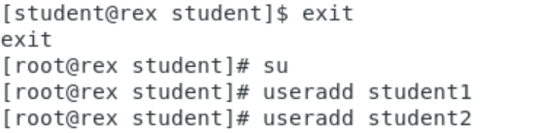
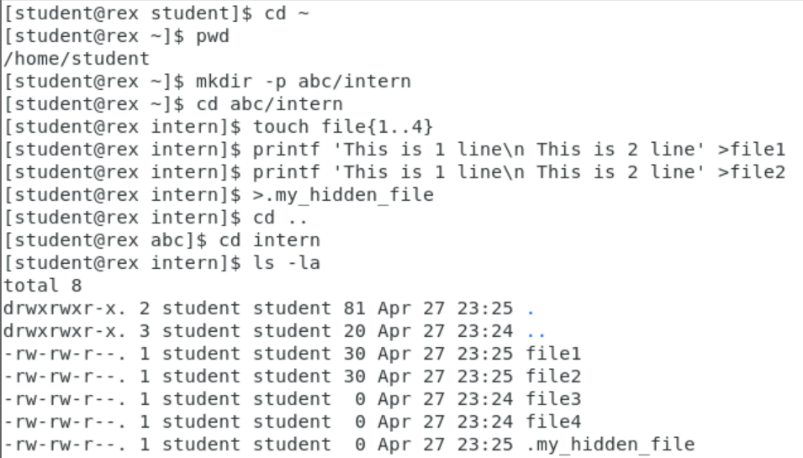


1.
2.

Slide 7
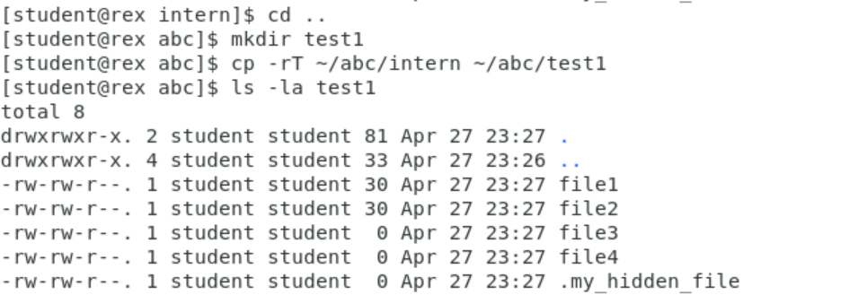
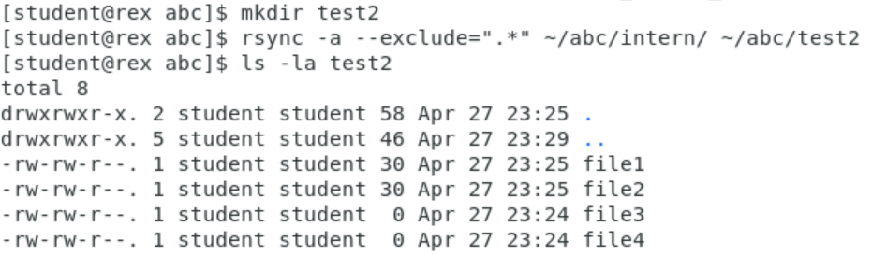
3.
4.

Slide 8
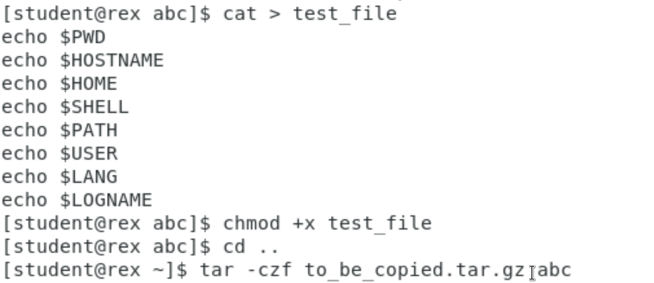
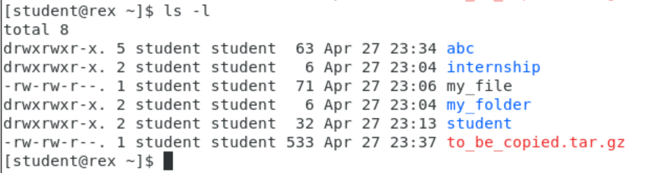
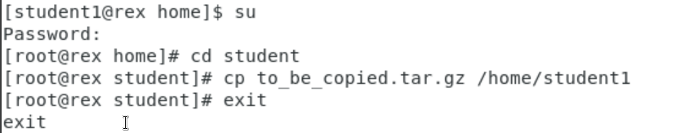


5.
6.
7.

Slide 9
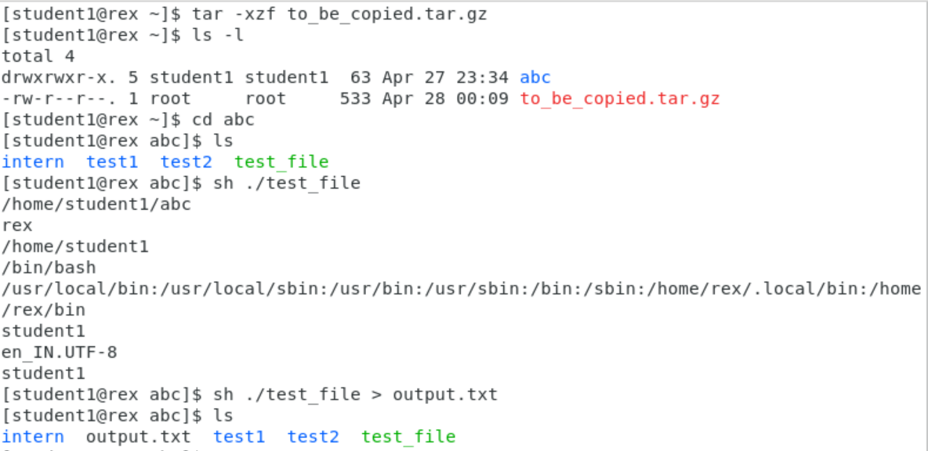
8.
9.

Slide 10
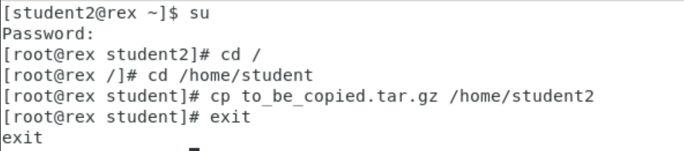
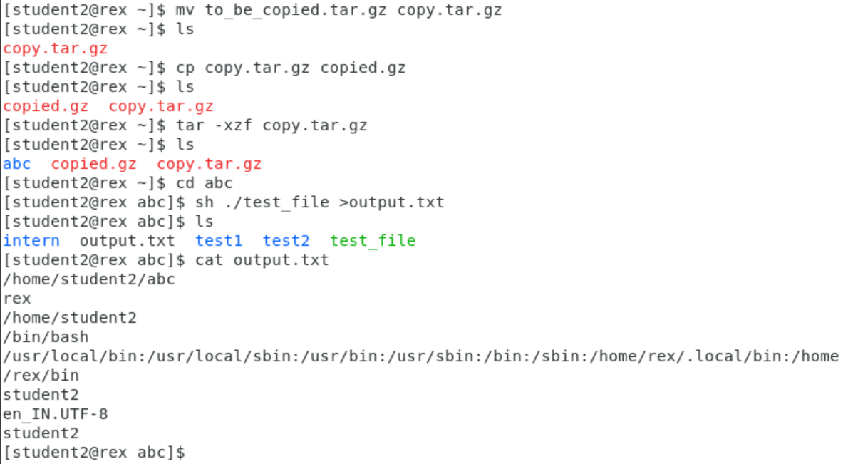
10.
11.

Slide 11
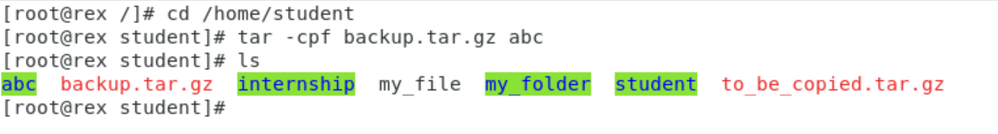

12.

Slide 12

Any Questions

Slide 13
Thank You

